Slide 1

-IFS-
A Psycho-Spiritual Model
Meta-perspective
Einat Avni Bronstein, MSW

Slide 2

The purpose of IFS from a spiritual perspective
OR
How does the IFS therapeutic process impact our spirituality:
It helps people heal their parts so they can:
Reduce the protectiveness that limits their ability to connect and makes them believe they’re separate.
Learn lessons related to increased connectedness.
Increase connectedness in all dimensions.
Bring more Self into the world.
Increased connectedness is the main goal

Slide 3

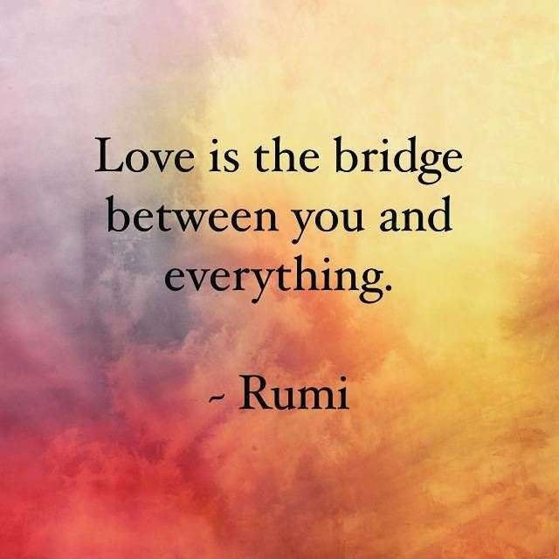

Slide 4

WE ARE SELF
Constraints Release
The Road Map For SELF To Shine Through:
Self-To-Part relationship protectors trusting, relaxing and stepping aside More Self presence Unburdening
Healing and transformation More Self presence
Higher degree of connectedness in all levels

Slide 5

When people go through unburdening:
They feel light, calm, connected
“I know I am loved”
“I feel I’ve come home”
“I feel deeply connected to this part/all my parts/everyone in my life/humanity”
The more people unburden, the more they experience their Self.
This Photo by Unknown Author is licensed under CC BY

Slide 6

The Reconnecting Impulse:
The hunger of Self to reunite with Self - We are wired for connection:
The more Self-led people become:
The more they feel connected inside
The more they seek to connect with other Self-led people
The more seeking and capable they are of connecting with a Higher Self and other dimensions

Slide 7
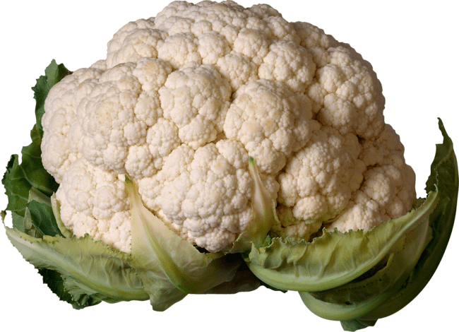
Two Relevant Systems’ Concepts to help understand our system:
Fractals: (Benoit Mandelbrot)
Characteristic patterns are repeated at each descending level.
Parts at any level are similar in shape to the whole.
Holons: (Arthur Koestler)
Everything is both a whole unto itself as well as a part of a larger whole. (‘hol’ is Greek for whole and ‘on’ is Greek for part). Our system is a holarchy.

Slide 8
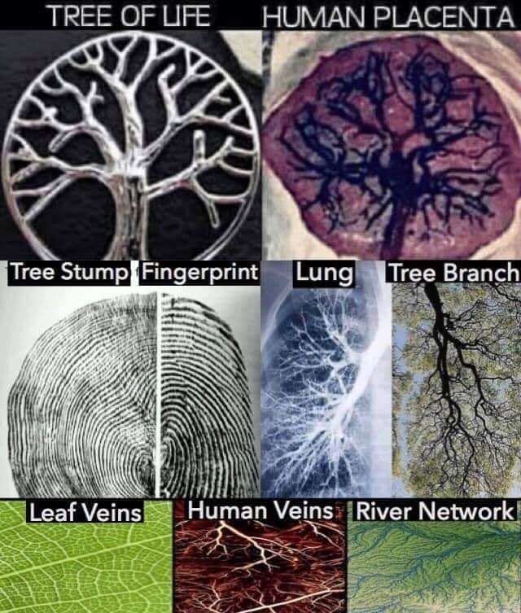

Slide 9

Self at all levels
Horizontally:
Unburdening improves the inner connections between:
The client’s Self and the Self of his or her parts
Part-to-part connections (from the parts’ Selves)
External connections to the Selves of other people.

Slide 10

Self at all levels (cont.)
Vertically (upwards & downwards)
Upwards:
Influxes of energy and light, calm, grace, or bliss that seems to come from a transcendent source
Connection to guides (sages; ancestors, power animals, and more)
Increasing interest in spiritual topics
Drawn to altruistic activities that bring more meaning to life
Can be in the present moment more fully

Slide 11

Self at all levels (cont.)
Vertically
Downwards:
Extends downward to what might be considered the Self of the Earth. Feeling more grounded, belonging in the world, more interested and loving of nature, finding nature to be a spiritual space and source of inspiration.

Slide 12

Embodying Self
Feeling more grounded also refers to being more at home in our bodies
Different parts might have different and even polarized ideas about how to be in the body
The Ascending path (Ken Wilber): parts want to avoid our pain by ascending above the physical and earthy involvements of this world, and find peace in ethereal spheres of consciousness. Tend to devalue or even deny the body, the senses, sexuality, the Earth, the flesh.
Might cause us to feel impatient and even contemptuous towards the struggles of our “human” parts and we attempt to abandon them by ascending to ‘higher planes’.
Could be a form of a ‘spiritual bypass’

Slide 13
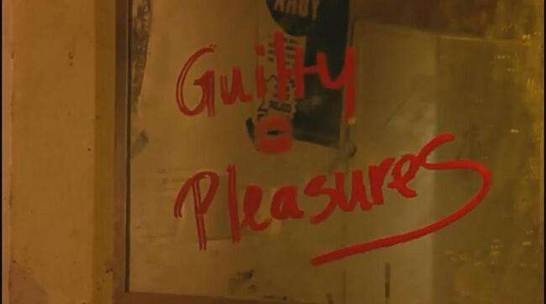
Embodying Self: (Cont.)
The Descending path – parts who want to revel in earthly pleasures. They celebrate the Earth, the body, the senses, and often sexuality. Find spirit in every sunrise, every moonrise, and practice their spirituality through their bodily experience. Sensations and emotions should be fully experienced and expressed.
Might be giving permission to every firefighter’s impulse and ignoring parts and others who are harmed by this.
Could be a form of a ‘spiritual bypass’

Slide 14

The IFS approach to the two paths:
A middle path which aims between those two and contains elements of both
Regarding the Ascending Path - “We came to this world not to leave it as soon as we can… but instead to bring more Self to it – to create more connection both horizontally and vertically”. (DS)
“If we embrace rather than ignore or disdain our parts, they will unburden and harmonize with our Self. They will experience the divinity within them”. (DS)
Regarding the Descending Path – “If we fully embody the Self, by definition we are bringing more of it to this world, so to that extent the goal of IFS is a descending goal. Full embodiment, however, does not require the full bodily expression of every extreme part of us”. (DS)

Slide 15

Once unburdened:
Most parts no longer crave full physical expression and are able to participate harmoniously with the rest of the system.
They can do this because THEIR Selves are in the lead.
The unburdening of parts
AND
embodiment of Self bring increased connectedness in all levels.

Slide 16

What are Unattached Burdens (UBs)?
Free-floating extreme beliefs, energies, or emotions that can be unloaded, rather then spiritual entities that possess people and are to be battelled with.
“I consider UBs to be far less human-like (even though you can interact with them) than parts. Instead, I believe they are the manifestation of extreme beliefs and emotions that our minds personify. Sending them out of the system as soon as possible seems to work well”
Robert Falconer THE OTHERS WITHIN

Slide 17

Releasing UBs
Robert Falconer THE OTHERS WITHIN US
:
Follow the client’s inner world – beliefs, imagery and myths.
Work with fear (yours and the client’s). “If you’re not afraid it can’t hurt you”. Curiosity is essential.
Assume it’s a part until proven otherwise. “what is your good intention for her?”; “Are you a part of her?”
Create some distance between the person and the UB. A ball of light. Notice cords or connections.
Offer healing to the UB “we are not here to punish or judge you; we want to send you to a place where you can heal” (The Healing Realms). Send it out
Rebalance the system. “does anyone miss it for any reason?”. Check all parts in the system to be sure nothing is left. Care for parts who are struggling.
Invite guidance and guides
Cleanup – classic IFS work with parts who were impacted by the UB’s presence (shame; fear; isolation; grief; etc.)

Slide 18

When people embody Self:
They are able to be Self without constraints.
They can connect Self-to-Self with others.
They are nourished by that connection and no longer need to manipulate others in different ways, but rather just enjoy being with them.
They also become more committed to reducing suffering in any way that they can.
“Where ever Self connects to Self there follows increased commitment to protecting that connection at all levels”. (DS)
This Photo by Unknown Author is licensed under CC BY

Slide 19

BURDENS AS LESSONS
Helping our parts heal doesn’t just reduce our suffering but also helps us transform and realign our lives.
The process of unburdening may enable us to acquire a meta perspective about our life's journey, which provides illuminating realizations and awareness about our path onwards.

Slide 20

When we have connected with our pain enough, listened to the stories of the pain and unburdened it enough, we may gain a new perspective on our suffering.
We may sense a clearer direction in our lives and have the ability to follow that direction.
Once our suffering is no longer a paralyzing,
oppressive force in our life,
it can become a lighthouse to show us the way.
We can then see our life’s purpose more clearly and chart
our course accordingly.

Slide 21

Our vision is to be connected from Self at all levels and dimensions of our existence - to all of our parts, to the people around us, to the world we live in, to that which is Higher than us, to the past, present and future.

Slide 22


Slide 23
THE FOREST by Nikita Gill
One day when you wake up,
you will find that you've become a forest.
You've grown roots and found strength in them
that no one thought you had.
You have become stronger and more beautiful,
full of life-giving qualities.
You have learned to take all the negativity around you
and turn it into oxygen for easy breathing.
A host of wild creatures live inside you
and you call them stories.
A variety of beautiful birds nest inside your mind
and you call them memories.
You have become an incredible
self-sustaining thing of epic proportions.
And you should be so proud of yourself,
of how far you have come from the seeds of who you used to be.

